Slide 1
Communicating through Generational Differences
IDS Conference 2013 Kerry Anne Keegan

Slide 2
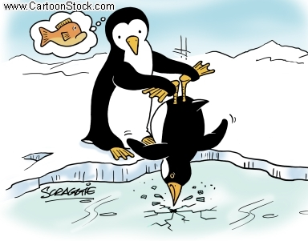
Be the change you wish to see in the world.
- (Not Gandhi)
Icebreaker time!
POP VOCAB QUIZ!
Notes:
Since we’re here talking about communication, let’s go ahead and facilitate some of our own by forcing you all to talk to one another

Slide 3
Turn to your left and say, “Good morning!”
You have 2 minutes to ask for your partner’s:
Name
Institutional affiliation or workplace
Job title
Personal definition of an “older worker”
Opinion of what’s the biggest challenge for older workers who are employed in libraries
Be prepared to share #5!
Notes:
If you don’t have a left hand partner, jump in on your right hand conversation

Slide 4
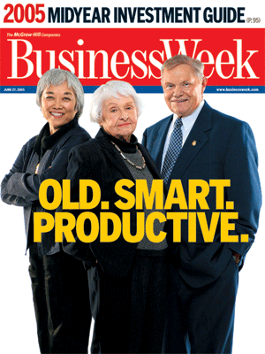
Older Workers
Age range is flexible, depending on source
US Department of Labor most commonly classifies as 55 years and older
Workforce surveys say majority of workers don’t consider themselves “older” until at least 60
However, these individuals believe their employers think of them as “older” by 50
http://www.dol.gov/odep/topics/OlderWorkers.htm

Slide 5
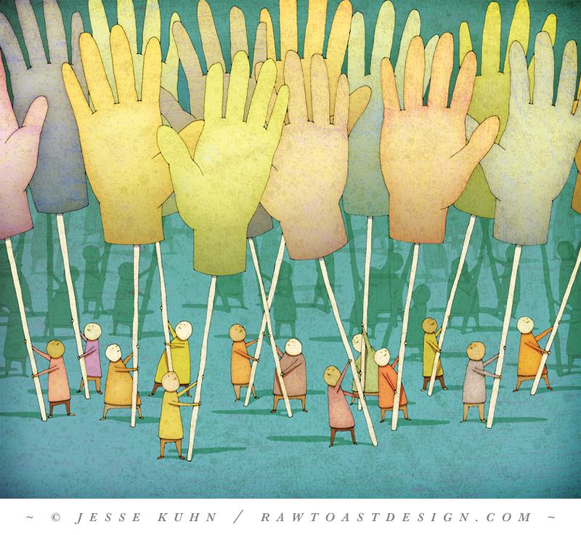
Show of hands:
Using this (vague) definition:
Who is an older worker?
Who has a coworker who’s an older worker?
Who has a direct supervisor who’s an older worker?
Who is a direct supervisor of an older worker?

Slide 6
We’re at a workshop on communication, let’s see some volunteers for # 5.
Tell us your PARTNER‘S name, affiliation, and what he or she thinks is the biggest challenge for older workers who are employed in libraries.

Slide 7
Turn to your right and say, “Good morning!”
You have 2 minutes to ask for your partner’s:
Name
Institutional affiliation or workplace
Job title
Personal definition of a “Millennial”
Opinion of what’s the biggest challenge for Millennials who are employed in libraries
Be prepared to share #5!
Notes:
Sharing

Slide 8
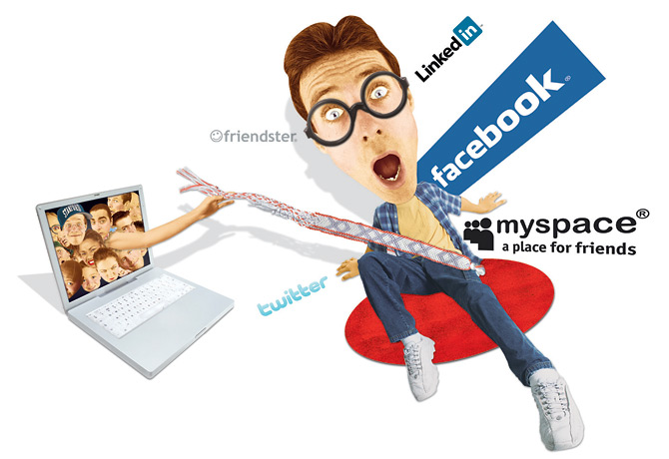
Millennials
Most research cites age range as currently between 18-29
Birth years between 1980 – 1999
(yes, I know -- math is hard)
http://www.dol.gov/odep/topics/OlderWorkers.htm

Slide 9
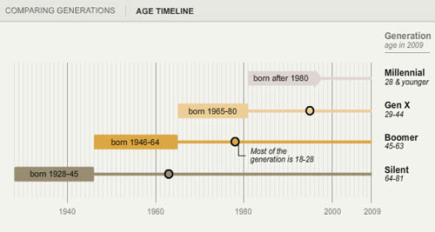
Older
worker
span
http://www.pewresearch.org/millennials/

Slide 10
Show of hands, again:
Using this (vague) definition:
Who is a Millennial?
Who has a coworker who’s an Millennial?
Who has a direct supervisor who’s a Millennial?
Who is the direct supervisor of a Millennial?

Slide 11
Speak up!
Tell us your PARTNER‘S name, affiliation, and what he or she thinks is the biggest challenge for Millennials who are employed in libraries.

Slide 12
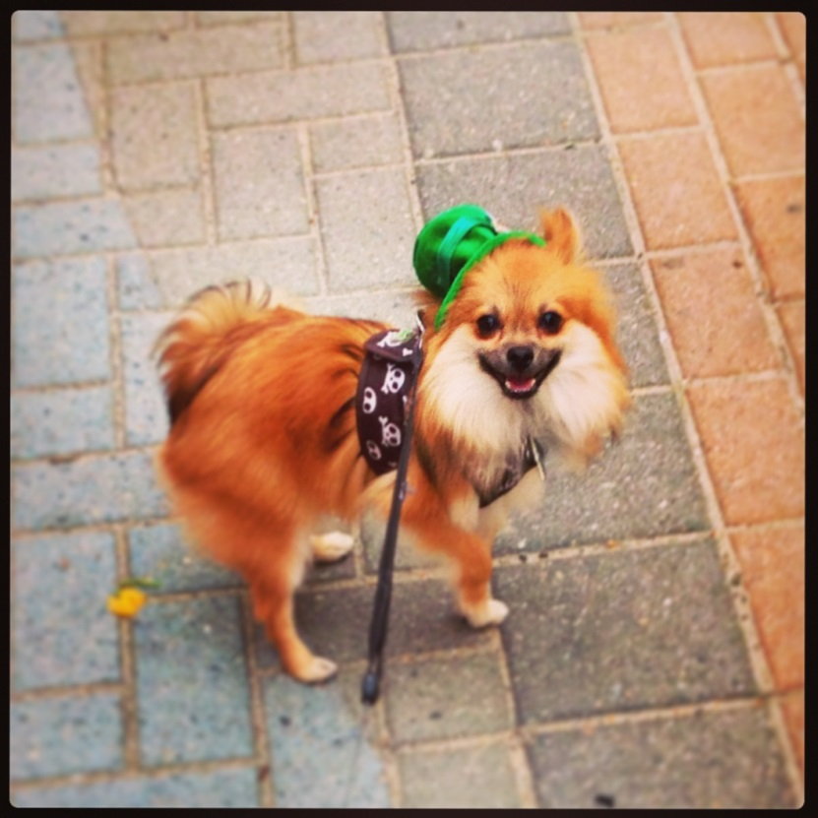
Kerry Keegan, MLIS, MPS
Kerry Keegan is currently employed as a Customer Service Agent for Atlas Systems and strives to attain its mission of “Library Excellence through Efficiency,” while supporting and training users in the company’s ILLiad, Ares, and Aeon products.
From 2009 to 2012, she served as Head of Access Services for Stony Brook University’s Health Sciences Library and as an IDS Mentor. Her interests include semantic technologies, andragogy, and creative uses of limited budgets.
She holds a BA in English from Stony Brook University, a MS in Library and Information Science from Queens College, and a Master of Professional Studies degree, with a focus on Human Resource Management from Stony Brook University.
She also serves as Section Editor for RUSA STARS and loves her dog, Remington, very much.
Remi the Pom
https://www.atlas-sys.com/ http://idsproject.org/
Notes:
Time gauge: estimate for 11:15

Slide 13
How I ended up here – talking about this
Graduated from library school in May 2009
Started as Head of Access Services in October 2009
Department was missing a supervisor since April
5 FTEs between 45 & 65
25 PTEs between 18 & 22
Spent 6 months struggling to teach same skillsets to separate groups
Started a Master of Professional Studies degree in December 2009
Moved on in February 2012
3 FTEs between 45 & 60
30 PTEs between 18 & 21
Notes:
Struggled for first six month

Slide 14
an· dra· go· gy (noun)
An MPS taught me about:
Methods of techniques used to teach adults
http://www.stonybrook.edu/spd/graduate/mpsonline.html

Slide 15
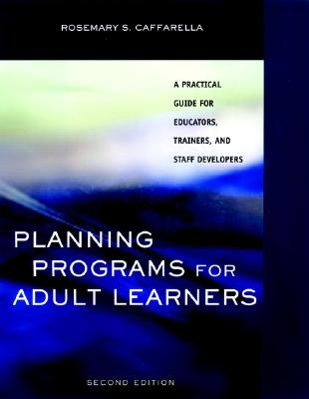
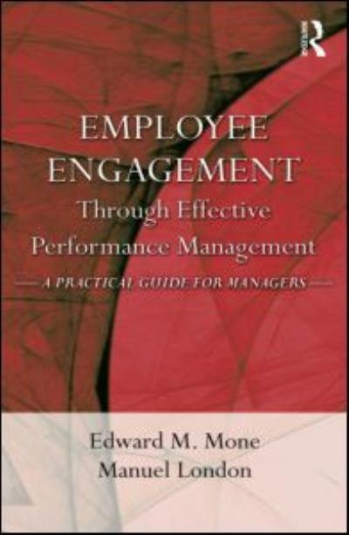
Some Helpful Resources
Planning Programs for Adult Learners by Rosemary Caffarella
Employee Engagement through Effective Performance Management by Edward Mone and Manuel London

Slide 16
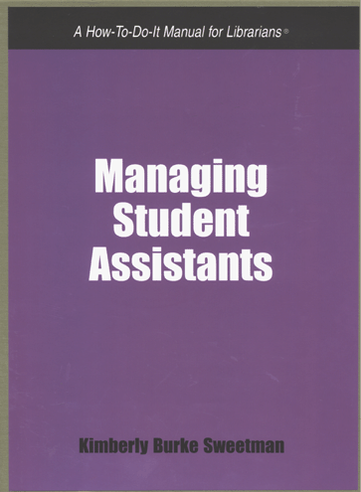
Some Helpful Resources
RenGen by Patricia Martin
Managing Student Assistants by Kimberly Sweetman

Slide 17
If you give a librarian a conundrum…
chances are, you’re going to get some statistics.

Slide 18
Before we really get started, PLEASE keep in mind:
Notes:
Since we’re here talking about communication, let’s go ahead and facilitate some of our own by forcing you all to talk to one another

Slide 19
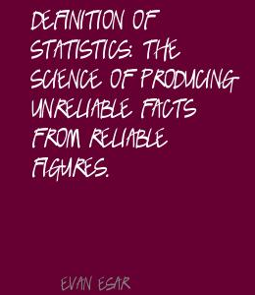
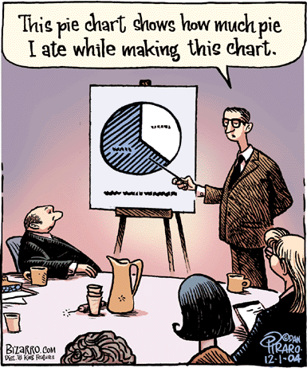

Slide 20
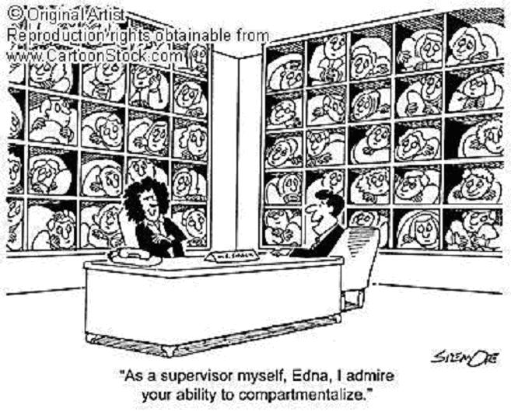
Notes:
Beware of stereotypes: not ev

Slide 21
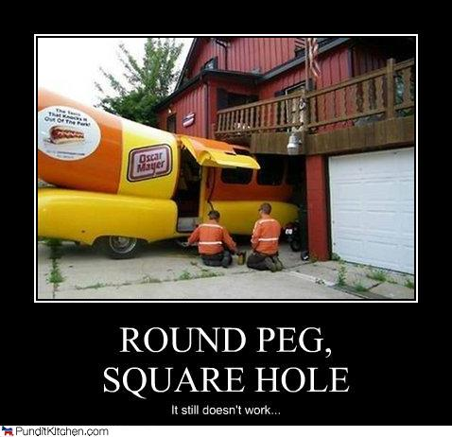
Avoid Pigeonholing
Not everyone will fall neatly into categories
People learn and communicate differently, even within statistical groups that might identify regularly occurring characteristics
These ideas and statistics are meant to spark connections between experiences with coworkers, supervisors, and subordinates
And maybe even recognizing some things about your own communication tendencies
Or at least what other people are assuming about you!

Slide 22
Starting at the Roots
Notes:
Time gauge: should be around 11:35

Slide 23
Learning Preference Differences
Millennials
Want to process information quickly and immediately. Prefer multiple sources
Prefer multi-tasking during parallel processes
Simultaneous music, phone, emails
Scan graphics to decide if text is worth referencing
Like peer groups with shared responsibilities
Learner-centric, with teacher as a guide
Prefer to construct purpose of knowledge from learning experience
http://niso.kavi.com/news/events/niso/.../MEC06-01-Breeding.pdf

Slide 24
Why Millennials are attractive library employees
Comfortable with constant, real-time communication
First “truly-wired generation”
Looking for careers and workplaces that provide change and learning opportunities
Sense of urgency in production and work pace
Over 55% hold ALA-accredited MLS/MLIS/MIS/MSIS
Over 20% are current MLS/MLIS students
ALA Survey from 2009: http://listsmart.osl.state.or.us/pipermail/libs-or/2009.../007814.html
http://www.foxbusiness.com/personal-finance/2011/04/18/tips-gen-y-engage-boomers-work

Slide 25
…and the respective challenges
More likely to change jobs or explore new career options
Less than 43% are likely to stay in current position for the next 5 years
Lowest rates of employer loyalty
Report highest levels of work-related distress and restlessness
http://www.dol.gov/odep/documents/af4ecaa2_02c6_4f75_b9db_d39ad7754bb4.doc

Slide 26
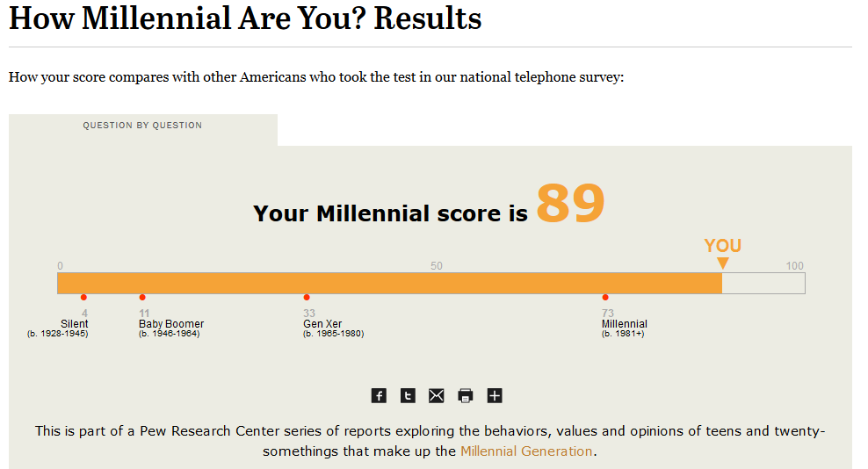
Just for Fun
http://www.pewresearch.org/quiz/how-millennial-are-you/

Slide 27
Learning Preference Differences
Gen X – Early Boomers
Detail- and goal-oriented work
Fast-paced, informal environment
Multi-tasking
Individual autonomy and project management
Wireless technologies
33-48
49-55
http://niso.kavi.com/news/events/niso/.../MEC06-01-Breeding.pdf

Slide 28
Gen X – Early Boomers in the Library
Fill majority of middle-manager roles, a wide-ranging level in libraries
Are looking for balanced, interesting careers. Libraries can offer many different aspects of technical involvement, face-to-face interactions, and research and learning opportunities.
Look for the ability to move around internally in organizations
http://www.dol.gov/odep/documents/af4ecaa2_02c6_4f75_b9db_d39ad7754bb4.doc
http://www.wisegeek.org/what-is-generation-x.htm

Slide 29
…and the respective challenges
This group has found itself lost between Older Workers who won’t or can’t leave the workplace and Millennials who are entering with the newest and most attractive skills
Being stuck in middle management can be stressful and demoralizing
May have trouble communicating workplace needs with others
Grew up under the Silent Generation and hardcore Boomers – who had no time for small fry concerns
http://www.dol.gov/odep/documents/af4ecaa2_02c6_4f75_b9db_d39ad7754bb4.doc

Slide 30
Learning Preference Differences
Older Workers
Want time to digest information after receipt
Prefer step-by-step, task-oriented processes
Read text first, review graphics as supplemental materials
Like individual responsibilities
Teacher-centered learning, with teacher as “sage”
Want purpose of instruction before it begins
Use to construct logical sequences
55 & up
http://niso.kavi.com/news/events/niso/.../MEC06-01-Breeding.pdf

Slide 31
Why older workers work out for libraries
Make up over 65% of library workforce
Willing to work different, fluctuating schedules
More willing to serve as mentors
Invaluable experience
High retention rates
55% likely to stay with current employer for next 5 years
Least likely group to feel “burned out”
Surveys indicate Boomers “live to work” and created the 60 hour work week
ALA Survey from 2009: http://listsmart.osl.state.or.us/pipermail/libs-or/2009.../007814.html
http://www.scribd.com/doc/15132651/Life-in-the-Baby-Boomer-library-world-a-survival-guide
http://www.dol.gov/odep/documents/af4ecaa2_02c6_4f75_b9db_d39ad7754bb4.doc
http://www.nasra.org/resources/aarpexecsumm.pdf.

Slide 32
…and the respective challenges
Employers worried about “brain drain” of aging, highly skilled workers
Higher costs of employment, related to earnings, health insurance, and pensions
Less likely to maintain and upgrade skills
Expect to encounter and feel that they are experiencing “age bias”
http://www.dol.gov/odep/documents/af4ecaa2_02c6_4f75_b9db_d39ad7754bb4.doc

Slide 33
Why Older Workers Aren’t Going Anywhere
Percentage of retirees with part-time jobs is on the rise
84% of employers expect older workers to transition to part-time after retirement
Accurately believe that full retirement creates a barrier to returning to workforce
71% believe older workers are first to be laid off during workforce reduction
86% believe that laid off younger workers are more likely to find new employment
2003 AARP survey: 46% of pre-retiree plan to work part-time during retirement
Harris Interactive Survey says 17% plan to work consistently; 38% will cycle in and out
Only ¼ of American workers are “very confident” that can retire when they’d like
Most surveyed doubtful of availability of Medicare and Social Security
http://www.dol.gov/odep/documents/af4ecaa2_02c6_4f75_b9db_d39ad7754bb4.doc
http://www.nasra.org/resources/aarpexecsumm.pdf.

Slide 34
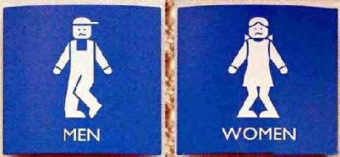
Bathroom Break! Snack Break! Be Back in 10 minutes!

Slide 35
Sorting through the Numbers

Slide 36
http://pewsocialtrends.org/pubs/751/millennials-confident-connected-open-to-change

Slide 37
Technology rules in the perception of generational gaps
79% Pew Research respondees say there are major differences between Boomers and Millennials
75% say major difference is in the way they use computers and new technologies
2/3 of the American public believes older people have better work ethics, morals, and greater respect for others than Millennials
2:1 ratio believe young people are more tolerant of different races and groups
Only ¼ say there are strong conflicts between Millennials and older people
http://pewsocialtrends.org/pubs/751/millennials-confident-connected-open-to-change

Slide 38
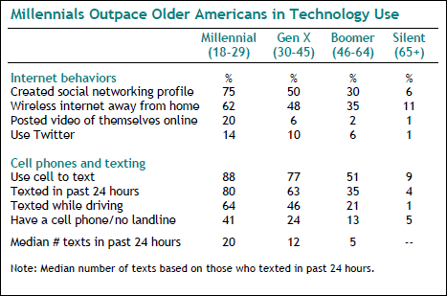
http://pewsocialtrends.org/pubs/751/millennials-confident-connected-open-to-change

Slide 39
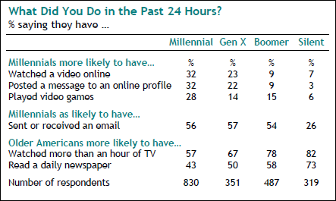

Slide 40
Practical Use in Communication Tips for talking with:

Slide 41
A Millennial Supervisor
Expect constant access to employees, with a high focus on wireless technologies
Require open and regular communication
Expect employees to maintain a positive, friendly work atmosphere
Like informal settings, but expect respect and acknowledgement of achievements, even if they’re coming from below

Slide 42
A Millennial Coworker
Do best when can develop professional and caring relationships between and among coworkers
Be open to discussing feelings and sharing
Function best with positive, peer support networks
Expect to work in groups with a lot of internal communication and idea creation
Want flexibility for themselves, which could affect others’ workflows

Slide 43
A Millennial Subordinate
Allow opportunities for sharing of personal experiences
Have a tendency to be overly confident, but provides a way to validate personal experiences
Create ways for them to take small leadership roles to expand actual knowledge
Require flexibility in work atmosphere, hours
Look for mentors that they can work alongside, instead of follow behind

Slide 44
A Gen X Supervisor
Unlikely to provide the level of positive and regular feedback that Millennial subordinates expect.
Should practice increased feedback
Up your workplace compassion – it will only help
Strong dislike for micromanagement might prevent adequate instructions
Don’t be afraid to ask, but understand when they might not be ready to provide

Slide 45
A Gen X Coworker
Sharing personal experiences and feelings between Boomer workers has not always been proper work etiquette, but it’s the way the workplace is heading
Start small and indicate an openness to hearing these
Preference of lateral career moves means looking to expand knowledge across sectors
Appreciate those who can facilitate this improvement and movement

Slide 46
A Gen X Subordinate
Have a tendency to prefer individual work; if necessary to push into group work, create places for individual accomplishments and make sure to acknowledge these separately and recognize achievements in front of the group
Backlash against the Boomer workaholic mentality – expect a better work/life mentality
Like opportunity to be flexible with responsibilities throughout organization
Prefer lateral career moves
Significantly motivated by money

Slide 47
An Older Worker Supervisor
Require the respect and acknowledgement of their lengthy experience
Forcing new concepts is unlikely to be taken well
New ideas should be backed by relating their purpose to similar concepts and express how they are improvements upon existing models
Understand that, even if you know a lot more about a specific topic, chances are you’ll never know as much as they do
Ask for this information and appreciate it when it’s shared

Slide 48
An Older Worker Coworker
Recruit their opinions and focus on respectful receipt
Looking for positive support from peers to assuage apprehensions about new techniques, technologies, and requirements
Defined the workaholic concept and expect others to feel the same
Define themselves as employees of an organization and less likely to move between employers or careers

Slide 49
An Older Worker Subordinate
Enjoys a role as mentor and trainer
Create opportunities for them to share and supervise
Regardless of your personal opinion on essential skillsets, acknowledge their wealth of knowledge and experiences that have been gained over the years
New learning must be performed in a safe and inclusive learning environment, which can lessen the anxieties of participants and improve likelihood of knowledge transfer
Give opportunities to strengthen problem solving and finding capabilities

Slide 50
Best Practices for Everyone & Food for Thought
Notes:
Time gauge: should be around 12:00-:05

Slide 51
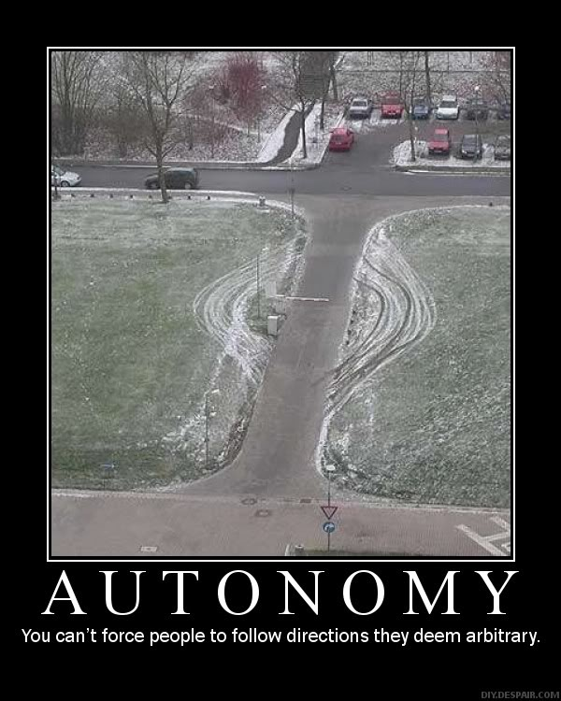
Expressing trust in coworkers and employees will improve worker satisfaction
Trust
Notes:
Time gauge: should be around 11:50

Slide 52
Autonomous workers are more motivated
Studies have shown that management which gives employees autonomy
Grew business 4 times faster than command and control management styles
Experienced only 1/3 of the employee turnover
“Responsibility for one’s work” was the #1 driver of employees’ discretionary action
Indicates that employees who are willing to go above and beyond have autonomy
Environments without autonomy train workers to wait for orders
Autonomous environments train workers to build confidence, self-efficacy, and resourcefulness
These employees are more likely do more with less and have a “can do” attitude
Exactly what libraries need right now
http://www.humannatureatwork.com/articles/management_development/Autonomy.htm

Slide 53
Supervisors should try:
Employees should try:
Discussing increased autonomy allowances with other managers
Gather feedback on potential areas for increased autonomy with employees
Ask if they have the tools, training, knowledge, and resources to run the library well
Give employees assignments, but let them determine the “how”
Let employees try new ideas, even if you’re doubtful of success possibilities
Turn failures into learning opportunities
Recognize and celebrate employees who experiment and generate new ideas
Ask for projects that put you in a leadership role
Determine what tools, training, and resources you need to become a more autonomous employee and ASK for them
Be able to provide specific examples and give the why and how of how they will help you help the library
Be willing to suggest new ideas
Don’t be afraid to fail if you learn from the experience
Recognize good ideas in yourself and in your coworkers
Providing positive feedback and celebrating peers opens up doors to further communication and improvement

Slide 54
Flexibility is a Must
Employers are more likely to recruit and retain workers when able to adjust with changing environments
Employers must find an organizational approach that co-benefits business and labor
Employees should understand that concessions go both ways
4 key types of employee-requested flexibility
Flexibility in schedules
Compressed work weeks, spreading out shifts, flextime
Flexibility in place
Office, satellite offices, telecommuting, combinations
Flexibility in how to accomplish work goals
Avoiding micromanagement, allowing employees to develop strategies that highlight personal styles, strengths, and preferences
Flexibility in careers
Interspersing full-time and part-time work, designating personal development time, allowing for sabbaticals and personal leave
Both groups cite flexibility as a top priority for workplace satisfaction
http://assets.aarp.org/rgcenter/econ/i11_work.pdf

Slide 55
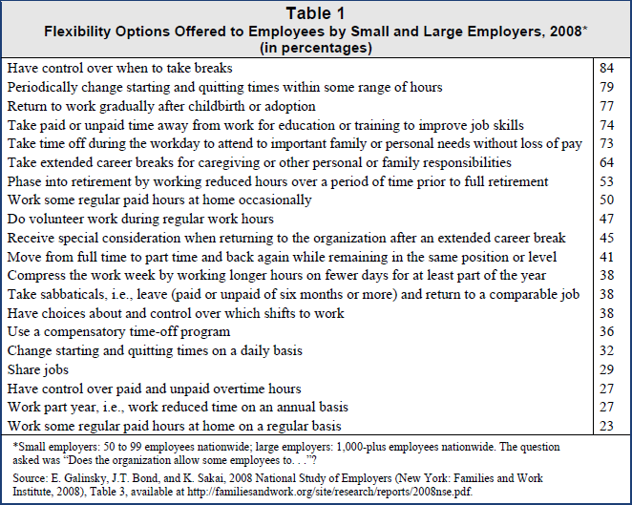
http://assets.aarp.org/rgcenter/econ/i11_work.pdf

Slide 56
Positive impacts of workplace flexibility
Employees are more likely to have
Greater engagement
Higher levels of job satisfaction
Stronger intentions to remain with employers
Less negative spillover from job to home and vice versa
Better mental health
Workers in more demanding jobs in less supportive workplaces report:
Higher stress levels
Coping difficulties
Worse moods
Higher levels of fatigue
Negative consequences for work and home lives
http://assets.aarp.org/rgcenter/econ/i11_work.pdf

Slide 57
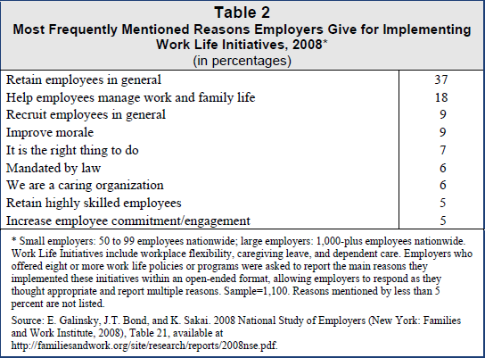
http://assets.aarp.org/rgcenter/econ/i11_work.pdf

Slide 58
Quick, but interesting tidbit
1.5 million retiring workers say they would have stayed on their jobs if employers had permitted them to work fewer hours with a corresponding reduction in pay.
By 2020, 25 million Baby Boomers, who make up more than 40 percent of the U.S. labor force, will be exiting the workforce in large numbers and leaving many jobs to be filled. With their departure, the work characteristics that define the Baby Boomer generation — results-driven, ambitious, idealistic, competitive, optimistic, and people-oriented — may be lost unless companies creatively develop strategies to simultaneously retain older workers and transition their knowledge to younger workers (Morton, Foster, & Sedlar, 2005). These workers will also take decades of accumulated organizational knowledge with them, and this “brain drain” could result in the loss of key information about customers or practices that could be devastating to organizations (Pitt-Catsouphes & Matz-Costa, 2009).
http://assets.aarp.org/rgcenter/econ/i11_work.pdf http://www.dol.gov/cgi-bin/leave-dol.asp?exiturl=http://www.gao.gov/products/GAO-07-433T&exitTitle=www.gao.gov&fedpage=yes

Slide 59
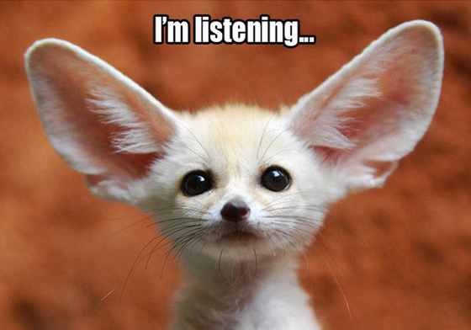
Employer-worker and worker-worker feedback must be constantly available and always constructive
Feedback
Notes:
Time gauge: should be around 11:50

Slide 60
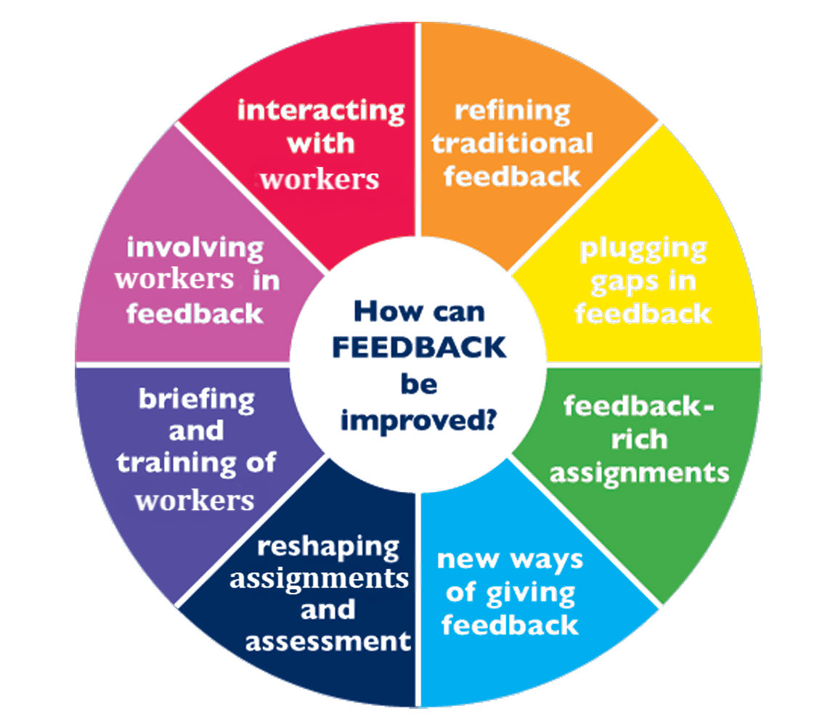

Slide 61
Generational Preferences
Boomers are often criticized for providing directives rather than guidance and rarely provide constructive or positive feedback
Baby Boomers will often quote statements such as “why should I thank them for doing their job” or “you get thanked for your work every pay day”
Millennials need instantaneous communication and feedback
If feel like not receiving enough, they have to be prepared to ask for it – but also need to feel that will not be ostracized or criticized for asking
Baby Boomers are motivated by respect, so by asking for advice and feedback, requestors are respecting their knowledge and experience

Slide 62
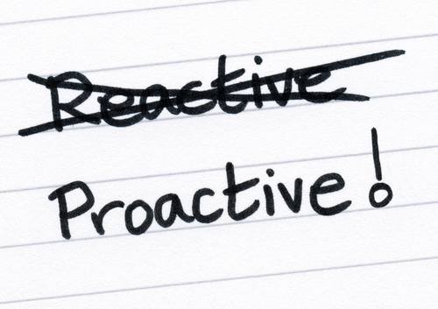
Proactive policy and practice responses can help retain good talent.
Proactivity
Notes:
Time gauge: should be around 11:50

Slide 63
Anticipate changes in physical, sensory and cognitive needs for older workers
Target specific work functions that may be modified to accommodate physical or cognitive demands of older workers’ activity
Providing for physical needs can help ease transition of changing technologies
Ergonomic mouse pads, office chairs, specialty keyboards
Be familiar with accessibility options in computer programs and workstation settings
Screen sizes, visual queues for sounds, optimizing visual displays, speech recognition
http://assets.aarp.org/rgcenter/econ/i11_work.pdf

Slide 64
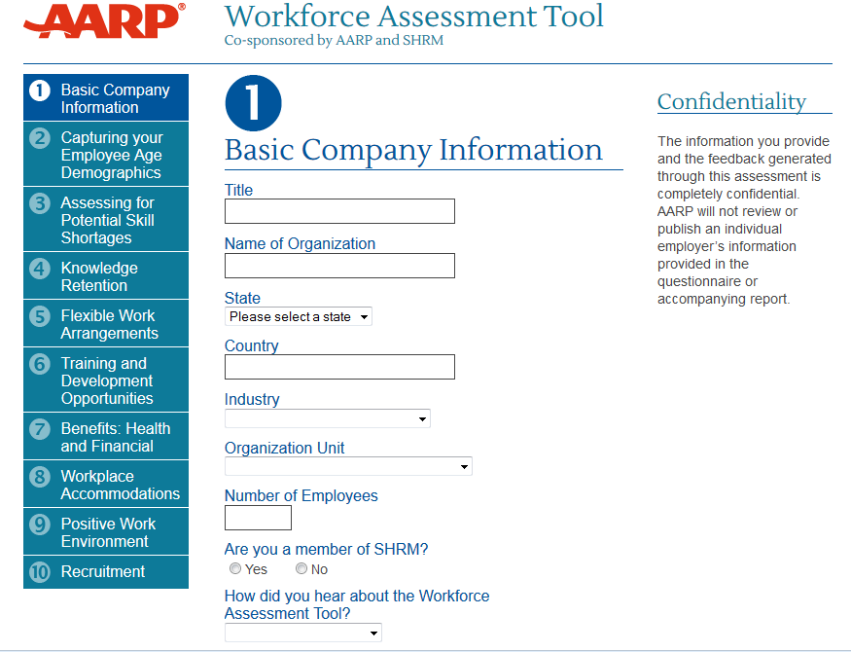
http://www.aarpworkforceassessment.org/

Slide 65
Anticipate changes required to retain and respond to Millennial needs as workers and users
1/3 of US workers have a boss that’s younger than them
15% by ten years or more
Millennials are not only current and future employees (and bosses), but also current and future users
Understanding personal views will help libraries thrive
50% of workforce will be Millennials in 2020
75% by 2030
Time to start rethinking:
Delivery of training and development
Mobile and social based preferences
Vacation time
Unlimited with a focus on performance, not face time
Commitment to job rotation starts and continues upon hire
http://www.forbes.com/sites/jeannemeister/2012/10/05/millennialmindse/

Slide 66
Transitioning Millennials into the Library Workplace
In Workforce 2020’s survey, 66% of Millennials agreed with the statement, “my personal drive can be intimidating to other generations in the workplace.”
Encourage Millennials to reframe the resistance to change they meet as a chance for dialogue by acknowledging criticism and using it as an instigator for further conversation.
Millennial librarians actively seek work environments and positions that challenge them, where they can challenge the status quo.
Supervisors of Millennials must work with them to teach when exceptions to the rules are appropriate.
Millennials tend to have a (over)confidence in their ability to lead without any prior experience, and believe that leadership is participatory.
Provide opportunities for leadership experience and professional development to channel this energy into productive outcomes.
http://www.forbes.com/sites/jeannemeister/2012/06/26/if-we-work-into-our-70s-what-happens-in-the-workplace/ http://www.thefreelibrary.com/Mind+the+gap%3A+technology,+millennial+leadership+and+the...-a0250885096

Slide 67
Millennial workplace values (by importance)
Workplace flexibility
Compensation
Career Progression
On-going opportunities for sharing and collaborating
All of us need to adopt a Millennial mindset, regardless of when we were born. Why? In order to thrive in the workplace of the future we need to be agile, digitally literate, use the latest social technologies and above all, be open to people of all cultures, since our workforce of the future will be increasingly multi-cultural, age diverse and global.
- Jeanne Meister, author of The 2020 Workplace
http://www.forbes.com/sites/jeannemeister/2012/10/05/millennialmindse/

Slide 68
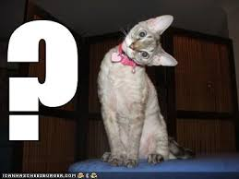
Questions? Comments? Stories to Share?
Notes:
Time gauge 12:20

Slide 69
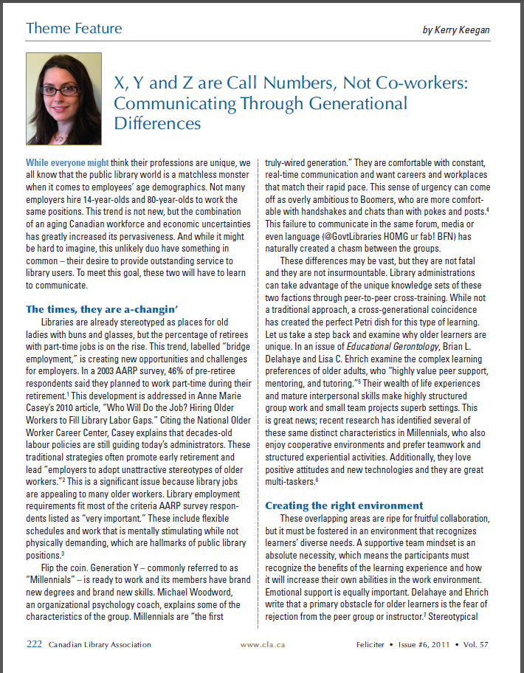
Thanks so much!
Kerry Anne Keegan
kkeegan@atlas-sys.com

